Slide 1

6th Grade Accelerated Math
Unit 9, Lesson 5 Describing and Interpreting Histograms – Part 1 Volume 2, pg. 63

Slide 2


Benchmark
MA.6.DP.1.4
Given a histogram or line plot within a real-world context, qualitatively describe and interpret the spread and distribution of the data, including any symmetry, skewness, gaps, clusters, outliers, and the range.
volume 2, pg. 63

Slide 3
Integrated Mathematical Thinking and Reasoning Standards
MA.K12.MTR.4.1 Engage in discussions that reflect on the mathematical thinking of self and others.
MA.K12.MTR.7.1 Apply mathematics to real-world contexts.
volume 2, pg. 63

Slide 4

Learning Target
I can qualitatively describe and interpret a histogram within a real-world context.
volume 2, pg. 63

Slide 5

Warm-Up
volume 2, pg. 64

Slide 6
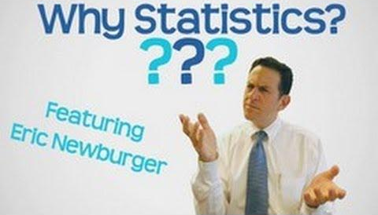

9.5.1 Warm-Up: Why Statistics?
Eric Newburger relates the need for studying statistics to the need for using a microscope. He discusses how a microscope is used to study small things. It’s also needed to study things like food poisoning at a larger level to aid in understanding diseases and how viruses spread.
In Mr. Newburger’s work, he explains you can take a big thing and shrink it down small enough to study and to understand. That’s the study of statistics. And when you want to understand something that is too small, you can use a tool (like the microscope), which is “why statistics.”
List two reasons why statistics are important.
volume 2, pg. 64

Slide 7

Guided Instruction
volume 2, pg. 64

Slide 8

9.5.2 Guided Instruction: Histograms
Numerical data can be displayed graphically in a variety of ways. One type of graph is a histogram.
A histogram is a visual display of numerical data using bars along a number line with no spaces between the bars. The height of each bar represents either the frequency or relative frequency of data within that interval.
volume 2, pg. 64

Slide 9

The histogram summarizes the lengths, in feet (ft), of a group of adult female sharks.
With your partner, discuss the labels for the vertical and horizontal axes.
How many sharks were between $15.5$ ft and $16$ ft?
How many total sharks were measured to create the histogram?
Shark Length
Frequency
Length (in feet)
volume 2, pg. 64

Slide 10
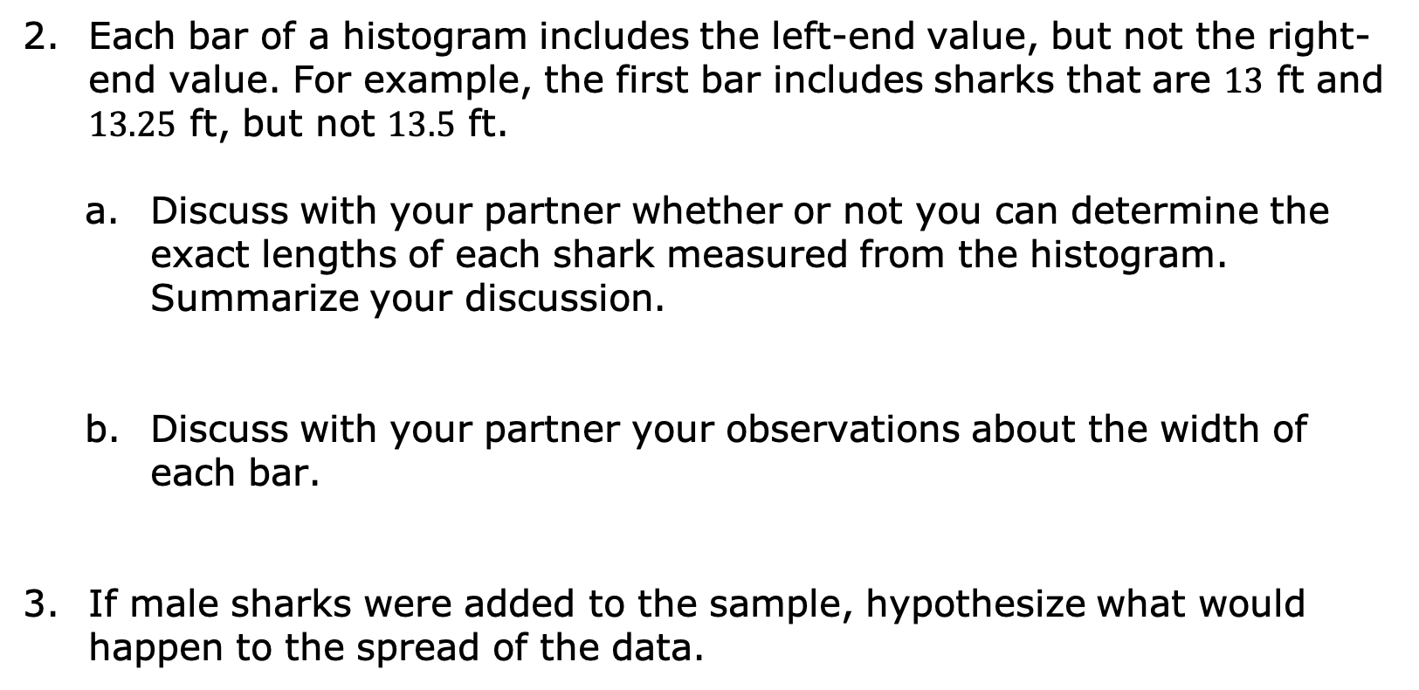
Each bar of a histogram includes the left-end value, but not the right-end value. For example, the first bar includes sharks that are $13$ ft and $13.25$ ft, but not $13.5$ ft.
Discuss with your partner whether or not you can determine the exact lengths of each shark measured from the histogram. Summarize your discussion.
Discuss with your partner your observations about the width of each bar.
If male sharks were added to the sample, hypothesize what would happen to the spread of the data.
volume 2, pg. 65

Slide 11

Exploration
volume 2, pg. 65

Slide 12

9.5.3 Exploration: Histograms
An earthworm farmer set up several containers of a certain species of earthworm so he could learn about their lengths. Lengths of earthworms provide information about their ages. The farmer measured the lengths of the earthworms in one container.
The farmer recorded the earthworms’ lengths, in millimeters, in a table and then created a histogram to display the data.
volume 2, pg. 65

Slide 13
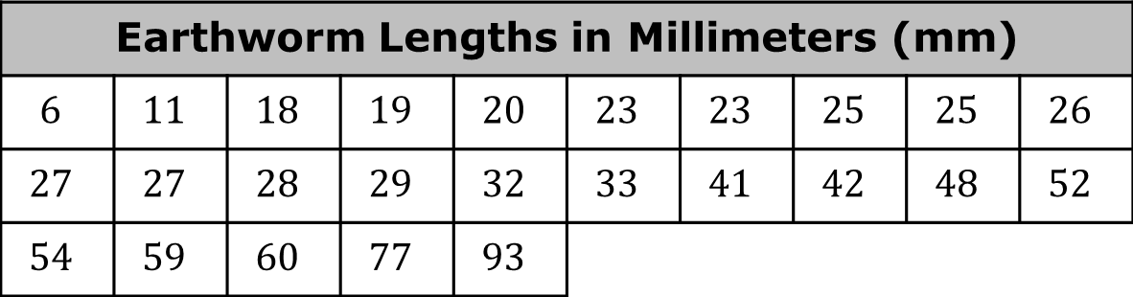
Earthworm Lengths in Millimeters (mm)
$$6$$ | $$11$$ | $$18$$ | $$19$$ | $$20$$ | $$23$$ | $$23$$ | $$25$$ | $$25$$ | $$26$$
$$27$$ | $$27$$ | $$28$$ | $$29$$ | $$32$$ | $$33$$ | $$41$$ | $$42$$ | $$48$$ | $$52$$
$$54$$ | $$59$$ | $$60$$ | $$77$$ | $$93$$
Frequency
Length (in millimeters)
volume 2, pg. 65

Slide 14
How many earthworms were measured in the data?
The number of earthworms measured can be determined from
The length of the shortest earthworm can determined from
the data set.
the histogram.
the data set and the histogram.
the data set.
the histogram.
the data set and the histogram.
volume 2, pg. 66

Slide 15
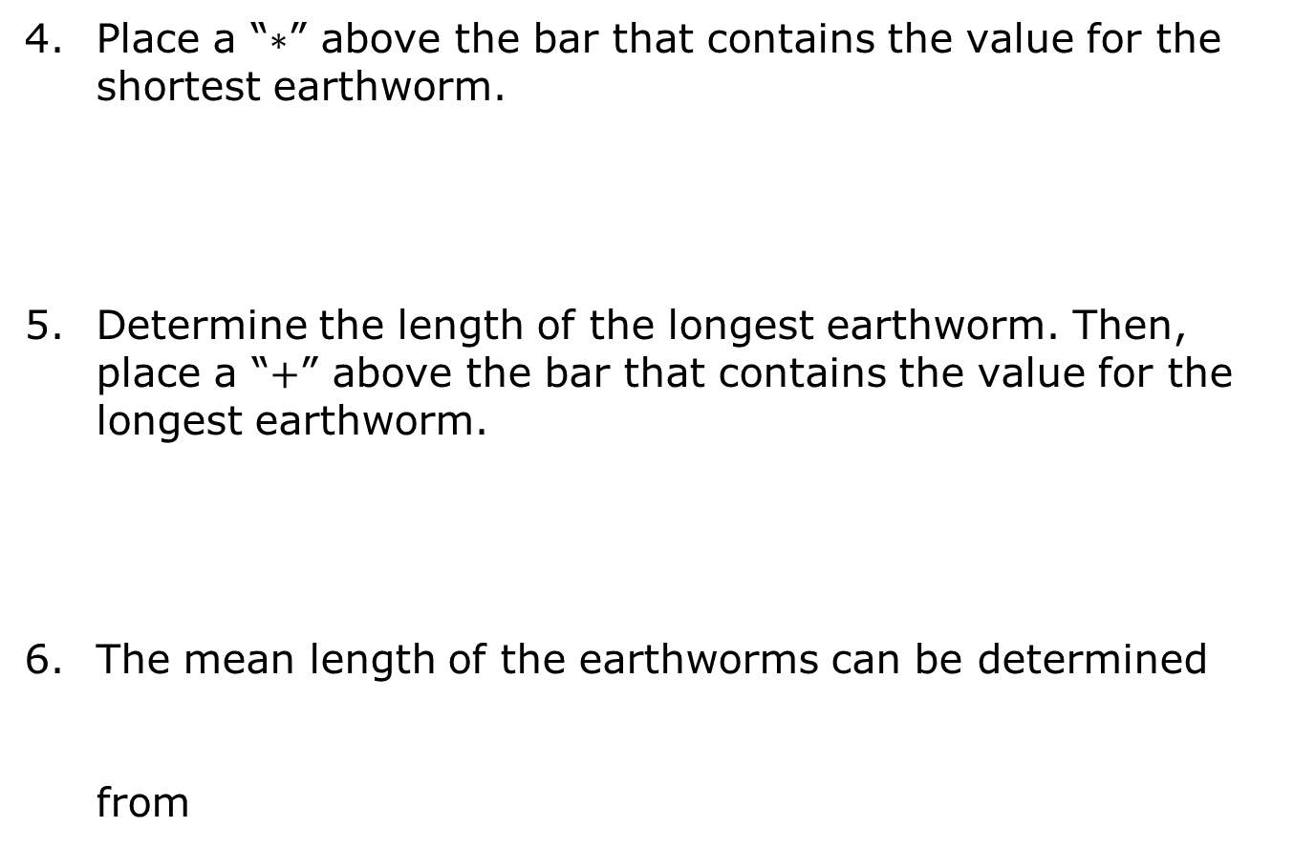
Place a “$∗$” above the bar that contains the value for the shortest earthworm.
Determine the length of the longest earthworm. Then, place a “$+$” above the bar that contains the value for the longest earthworm.
The mean length of the earthworms can be determined from
the data set.
the histogram.
the data set and the histogram.
volume 2, pg. 66

Slide 16
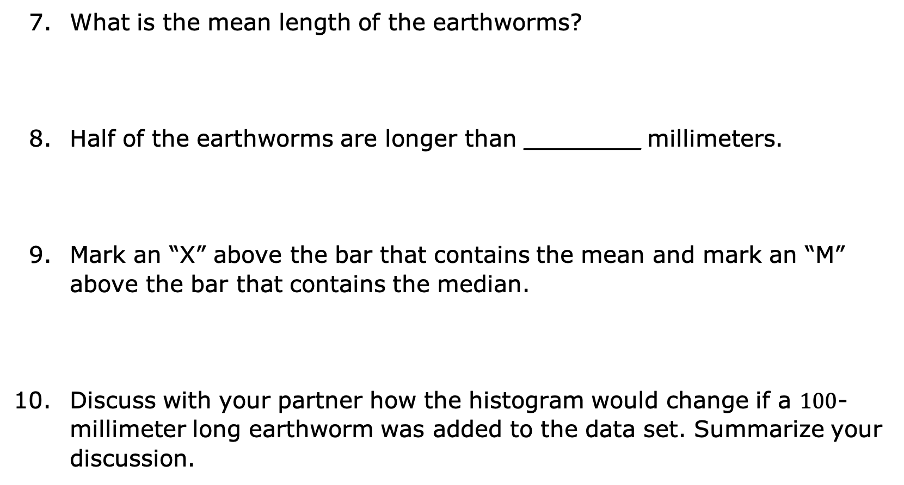
What is the mean length of the earthworms?
Half of the earthworms are longer than ________ millimeters.
Mark an “X” above the bar that contains the mean and mark an “M” above the bar that contains the median.
Discuss with your partner how the histogram would change if a $100$-millimeter long earthworm was added to the data set. Summarize your discussion.
volume 2, pg. 66

Slide 17

Try It
volume 2, pg. 67

Slide 18


9.5.4 Try It: Analyzing Histograms
In a study of wild bears, researchers measured the weights, in pounds (lb), of $143$ wild bears that ranged in age from newborn to $15$ years old. The data was used to make the histogram shown.
Could this sample contain a bear weighing $250$ lbs? Explain.
Mark a “$∗$” above that bar that would contain a
$250$-lb bear.
Wild Bear Weight
Frequency
Weight (in pounds)
volume 2, pg. 67

Slide 19
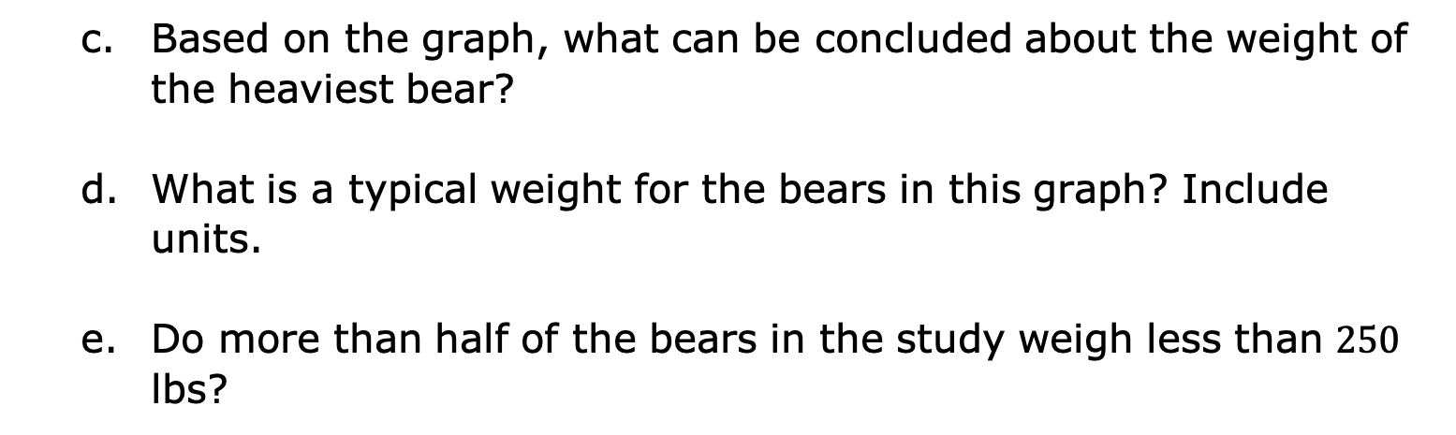
Wild Bear Weight
Frequency
Weight (in pounds)
Based on the graph, what can be concluded about the weight of the heaviest bear?
What is a typical weight for the bears in this graph? Include units.
Do more than half of the bears in the study weigh less than $250$ lbs?
volume 2, pg. 67

Slide 20

Your Turn
volume 2, pg. 68

Slide 21
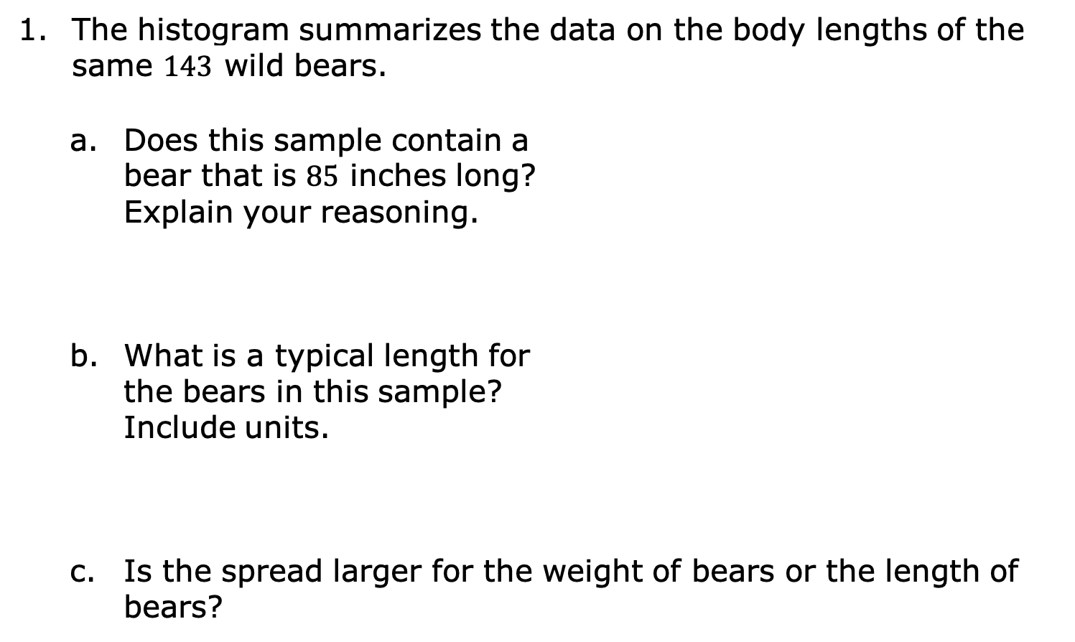
9.5.5 Your Turn!
The histogram summarizes the data on the body lengths of the same $143$ wild bears.
Does this sample contain a bear that is $85$ inches long? Explain your reasoning.
What is a typical length for the bears in this sample? Include units.
Is the spread larger for the weight of bears or the length of bears?
Body Length
Frequency
Length (in inches)
volume 2, pg. 68

Slide 22

Wrap-Up
volume 2, pg. 68

Slide 23
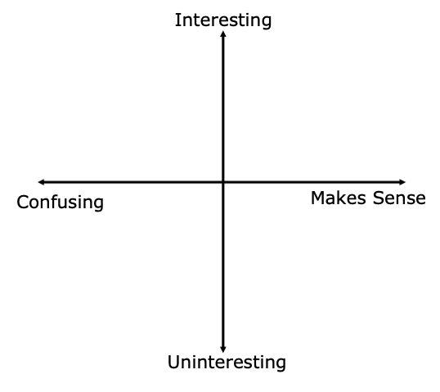
9.5.6 Wrap-Up: Reflection
Plot a point in one of the quadrants below to indicate your level of understanding of today’s learning target: “I can qualitatively describe and interpret a histogram within a real-world context.”
volume 2, pg. 68

